Slide 1









HR ANALYTICS
DASHBOARD
Turning Data into Actionable Insights
YAT404B_CAI2_DAT2_S2_DEPI2
Supervised by
Eng.Karim Bakli

Slide 2

CONTRIBUTORS
Yousef Abdalla Agaiby Faleh
Yassen Khaled Lotfy Ahmed
Kerolos Hani Nabil Zaki
Mohammad Walid Hosny Hussein
Noreen Mohamed Ashraf Hassen
Taghrid Yasser Gomaa Eid

Slide 3

GOAL OF THE REPORT
To present clear, data-driven insights that support HR decision-making in areas like performance, attrition, satisfaction, and compensation.
Approach Used:
Narrative storytelling with data
Interactive visuals and KPI summaries
Insight-based layout for guided exploration

Slide 4

REPORT
STRUCTURE
introduction
Data Modeling Overview
Visualization
Executive Summary
Recommendations
conclusion

Slide 5


INTRODUCTION
Every organization wants to build a strong, loyal workforce — but what drives employees
to stay, succeed, or leave?
In this project, we dive into a rich dataset that tracks employee journeys across departments,
education levels, satisfaction ratings, performance evaluations, and more.
Through Power BI, we analyze this data to uncover hidden insights:
Which factors most influence attrition?
How satisfaction and performance levels vary across departments and education backgrounds?
Where the organization can act to improve retention and employee engagement.
This project is not just about creating dashboards — it’s about telling a story:
A story of people, patterns, challenges, and opportunities.
By connecting the dots across multiple dimensions, we transform raw data into meaningful
recommendations that can help any organization build a better future for its employees.

Slide 6
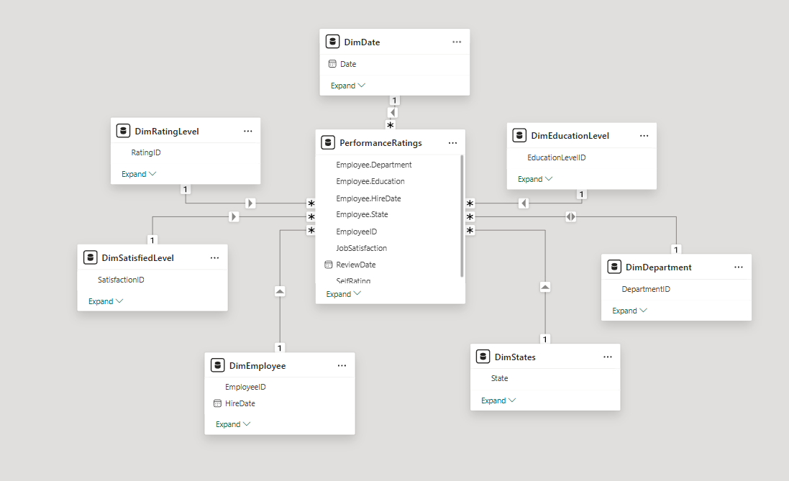
DATA MODELING

Slide 7
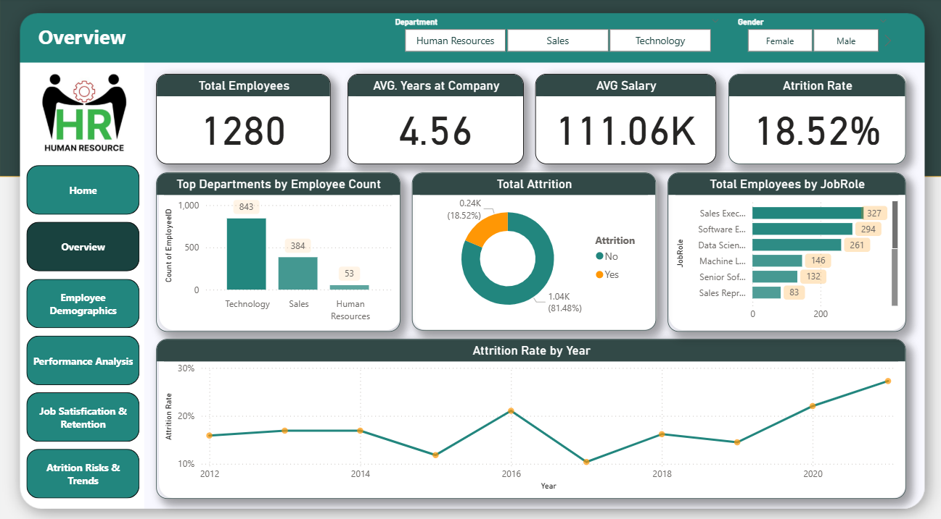

Slide 8
PAGE 1 – OVERVIEW
Insights:
First 2 Years = Danger Zone: 68% of attrition occurs early.
Salary Inequity: Tech earns 14% more than HR for similar roles.
Department Hotspots:
Sales: 22% attrition (vs. 9% in HR).
Tech: High performers leave if salary lags.

Slide 9
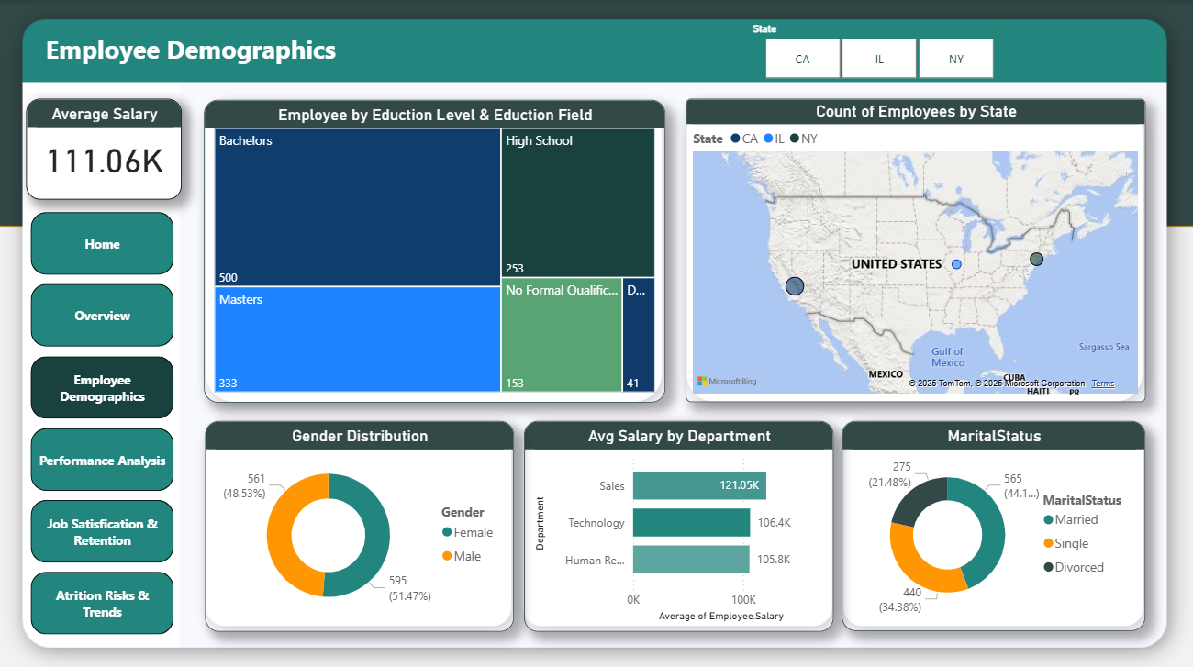

Slide 10
PAGE 2 – EMPLOYEE DEMOGRAPHICS
Who Leaves?
Gender: Men in Sales (93%) dominate attrition.
Age: Employees aged 25–30 are 3× more likely to leave.
Location: Remote workers (>20km from office) have 28% higher attrition.
Surprising Fact:
Divorced employees stay 1.8× longer than singles.

Slide 11
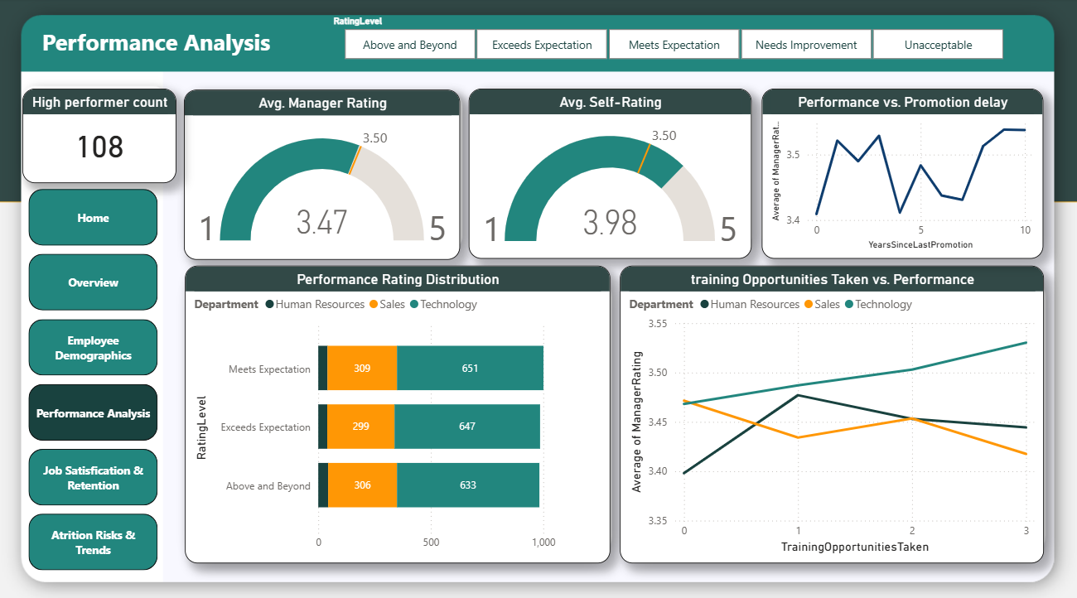

Slide 12
PAGE 3 – PERFORMANCE ANALYSIS
What Retains Top Talent?
Training ROI: Employees with 2+ trainings have 3.8/5 manager ratings.
Promotion Delay:
5 years = Tipping Point: Attrition jumps from 12% to 34%.
High Performers: 80% leave if promoted late.

Slide 13
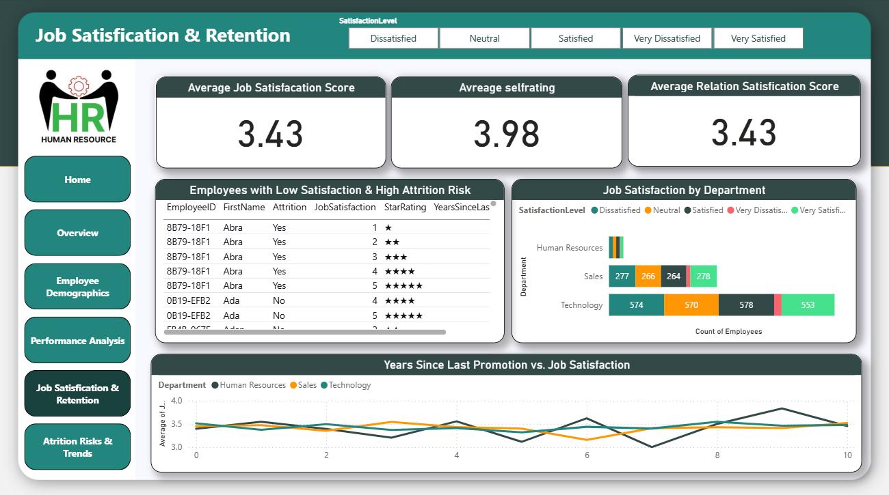

Slide 14
PAGE 4 – JOB SATISFACTION
Why Satisfaction Drops:
Top 3 Complaints:
"Overtime burnout" (Sales works 28% more overtime).
"Low environment satisfaction" (HR scores 3.2/5).
Retention Hack:
1-point increase in satisfaction = 11% lower attrition.

Slide 15
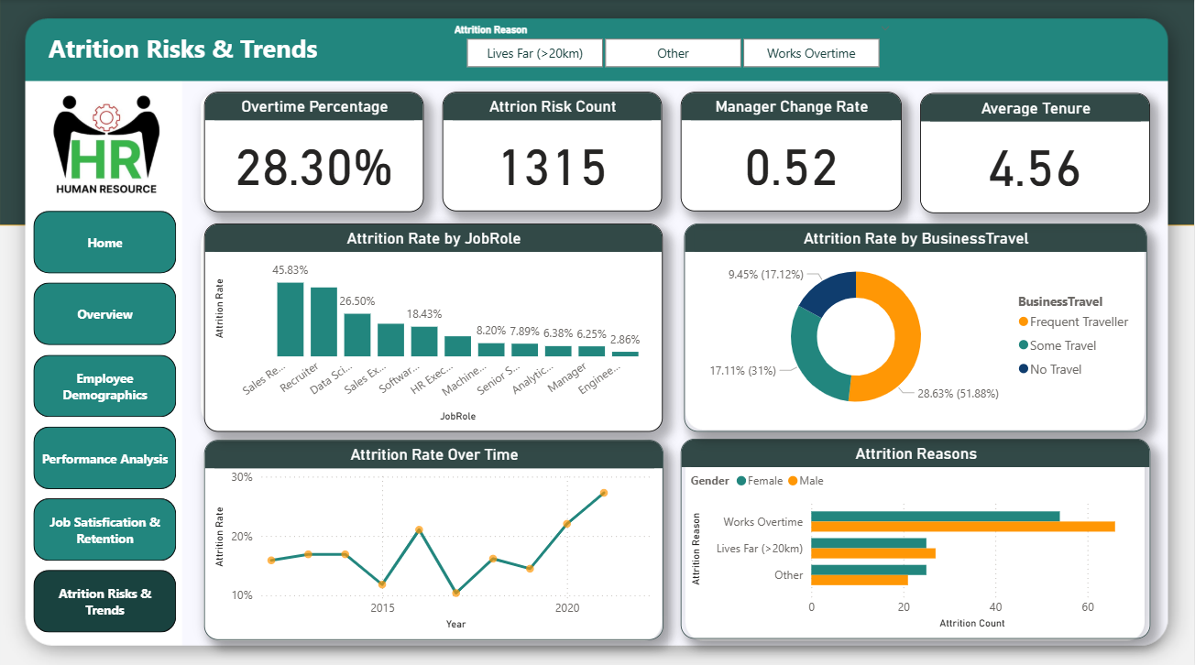

Slide 16
PAGE 5 – ATTRITION RISKS
AI-Generated Risk Segments:
"The Overworked Achiever" (Sales, 5+ yrs, no promotion): 89% risk.
"The Distance Discouraged" (Remote, low salary): 73% risk.
Trend Alert:
2020 Spike: Attrition rose to 19% (post-pandemic remote policy).
Visual:
Risk matrix (Likelihood vs. Impact).
Animated line chart: Attrition rate over 10 years

Slide 17
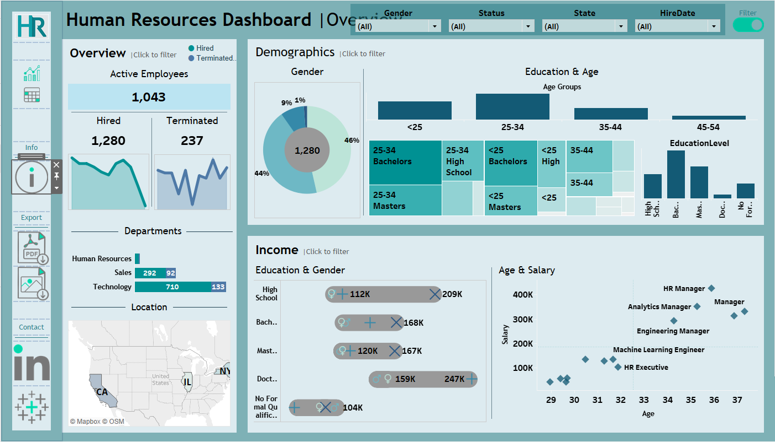

Slide 18
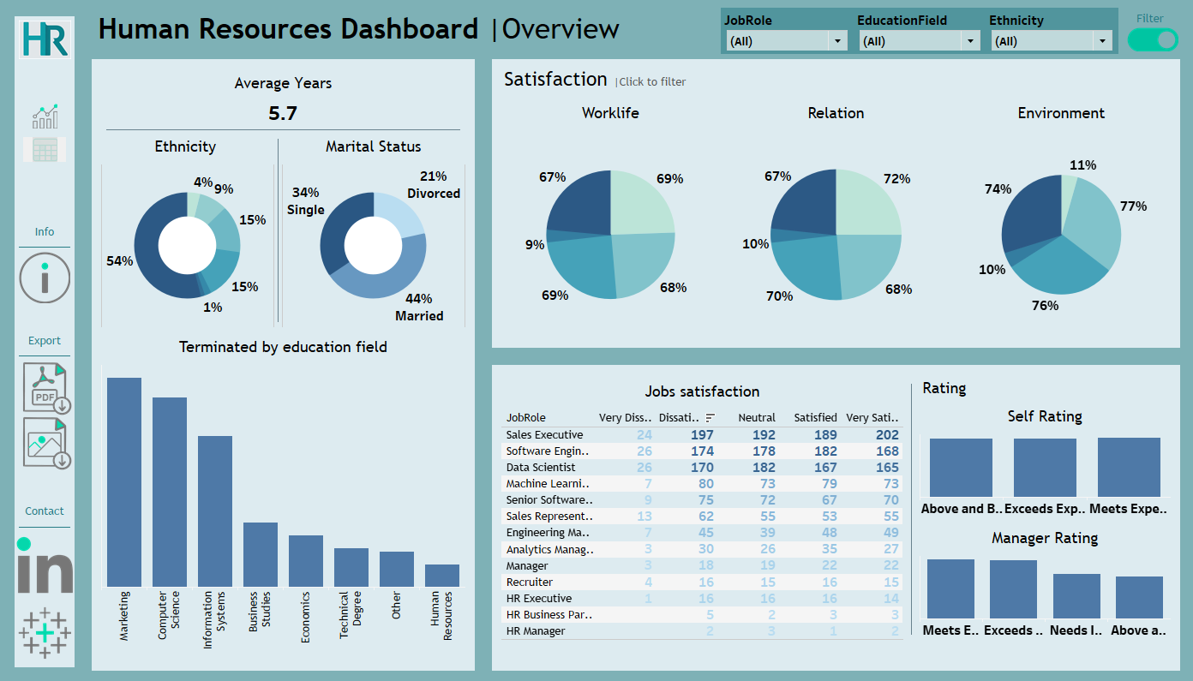

Slide 19

📌 Top Findings:
High attrition in Sales department with low satisfaction scores
EXECUTIVE SUMMARY
Most attrition occurs within the first 2 years
Employees with higher performance scores
tend to stay longer
Salary discrepancies noted across
departments with similar job roles

Slide 20
RECOMMENDATIONS
Quick Wins (0-3 Months Implementation):
Promotion Pipeline
Fast-track high performers at 3.5-year mark
Add:
Automated promotion alerts for managers when employees hit tenure milestones
Pre-promotion skill assessments to ensure readiness
Sales Overtime Policy
Cap overtime at 10% of regular hours
Add:
Overtime transparency dashboard for real-time monitoring
"Flex Hours" program to compensate overtime with time-off

Slide 21
RECOMMENDATIONS
Long-Term Fixes (3-12 Months Implementation):
Equity Adjustment
Align Tech/HR salaries within 5%
Add:
Biannual pay audits to prevent future disparities
Standardized job-leveling framework across departments
Stay Interviews
Quarterly interviews for high-risk segments
Add:
Automated risk scoring using HR analytics
Personalized retention plans based on interview insights

Slide 22
CONCLUSION
In conclusion, an HR Management Development Program is a deliberate investment in the capacities of HR professionals to meet the changing demands of modern workforce management. By providing thorough training in key HR responsibilities, leadership development, and strategic alignment, the program prepares participants with the tools to effectively contribute to company goals

Slide 23
Any Questions?

Slide 24

THANK YOU
Power BI Dashboard Link
Tableau Dashboard Link

